Slide 1
M.KUMARASAMY COLLEGE OF ENGINEERING , KARUR.
Register Number : 927623BEC173,927623BEC174
Name : REVANTH BALAJI S R
RITHIK SURIYA M
Date : 04-06-2025

Slide 2
TITLE OF THE PROJECT
CHARITY DONATION MANAGEMENT SYSTEM

Slide 3
Abstract
This project presents a Charity Donation Management System developed using SQL to efficiently manage and organize donor, donation, campaign, and beneficiary data. By leveraging SQL, the system ensures accurate data storage, retrieval, and reporting, enhancing transparency and accountability in charitable operations. Core features include donor registration, donation tracking, and fund allocation, all managed within a relational database. The system supports generating detailed reports and performing queries to analyze fundraising performance and donor behavior. Automation of these processes reduces manual workload and improves overall efficiency. With a structured backend, the system is scalable and suitable for both small and large nonprofit organizations. It ultimately aims to build trust and improve the effectiveness of donation management through reliable data handling.

Slide 4
Literature Review
Year | Authors | Title of the Paper | Algorithm/ Methodologies/ Techniques | Findings
2020 | John Doe, Jane Smith | A Charity Donation Management System Using Blockchain Technology | Random Forest , Support Vector Machine (SVM) , K-Nearest Neighbors (KNN) | Blockchain ensures transparency, security, and accountability in charity donations
2021 | Michael Brown, Alice Lee | Charity Donation Prediction Using Machine Learning | Cloud storage and distribution algorithms | Machine learning models effectively predict donor behavior and improve fundraising strategies

Slide 5
Problem(s) Identified
Lack of Transparency: Donors often have limited visibility into how their contributions are being used, leading to concerns about fund mismanagement or fraud.
Inefficient Fund Allocation: Many charity systems lack efficient mechanisms for tracking and optimizing the allocation of funds to ensure that donations reach the intended causes.
Fraudulent Activities: Charities are vulnerable to fraudulent donations and misuse of funds due to insufficient security measures, which can damage donor trust.
Engagement and Retention Challenges: Charities struggle to keep donors engaged, with many platforms failing to offer personalized experiences or incentives that encourage repeat contributions.

Slide 6
Proposed Solution
Design tables for Donor, Charity, and Donation.
Link tables using foreign keys (DonorID and CharityID).
Enforce data validation (e.g., valid email, positive donation amount).
Create queries and reports for tracking donations and performance.
Build a user-friendly interface for managing data. Implement security measures to protect sensitive information.

Slide 7
Objectives
Track Donor Information: Efficiently store and manage donor details such as DonorID, Name, and Email.
Record Charity Information: Store essential details of charities, including CharityID, CharityName, and Description.
Capture Donation Details: Log donations made by donors, including Amount and Date of each donation.
Establish Relationships: Link donors and charities through donations, allowing the system to track who donated to which charity and how much. Enable Reporting: Provide a structure to easily query and analyze donation data, donor contributions, and charity performance.

Slide 8
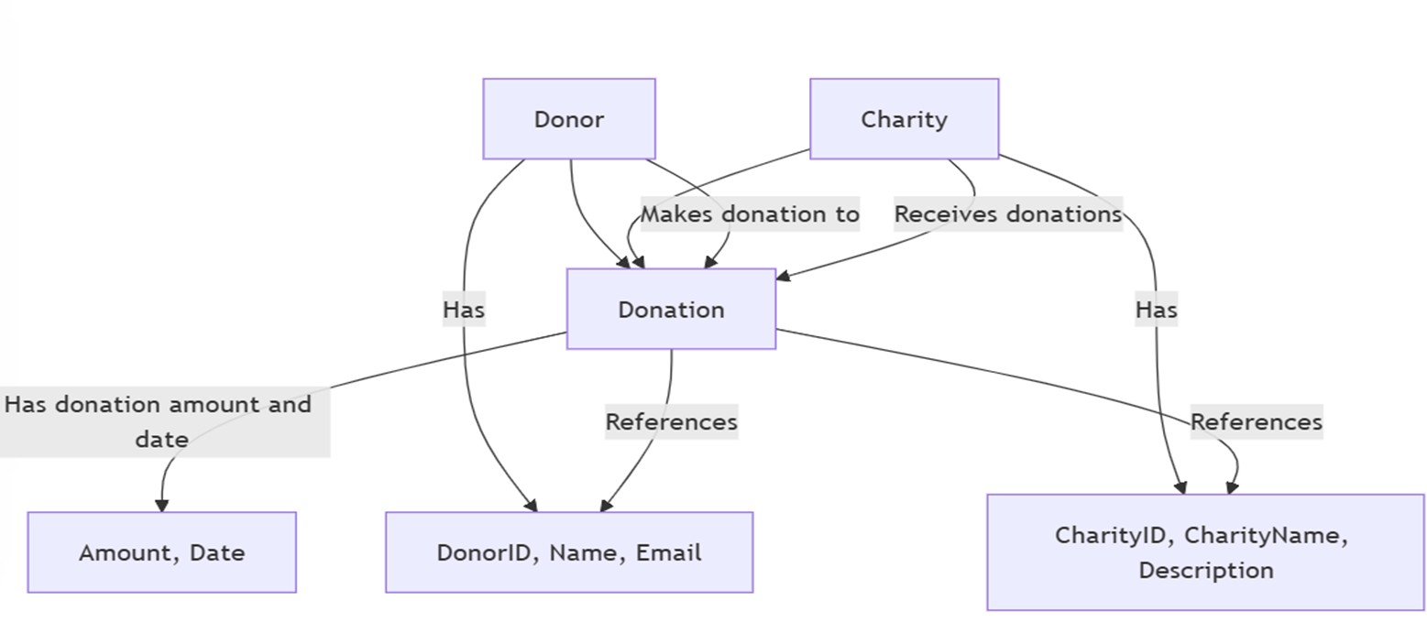
Architecture Diagram

Slide 9
Architecture Diagram Explanation
Entities: The system has three main entities: Donor, Charity, and Donation.
Donor Attributes: Donors are identified by DonorID, Name, and Email. Charity
Attributes: Charities are identified by CharityID, CharityName, and Description.
Donation Bridge: The Donation entity links Donors and Charities, capturing Donation Amount and Date.
Relationships: A Donor can make multiple Donations to different Charities, and each Donation is linked to one Charity.

Slide 10
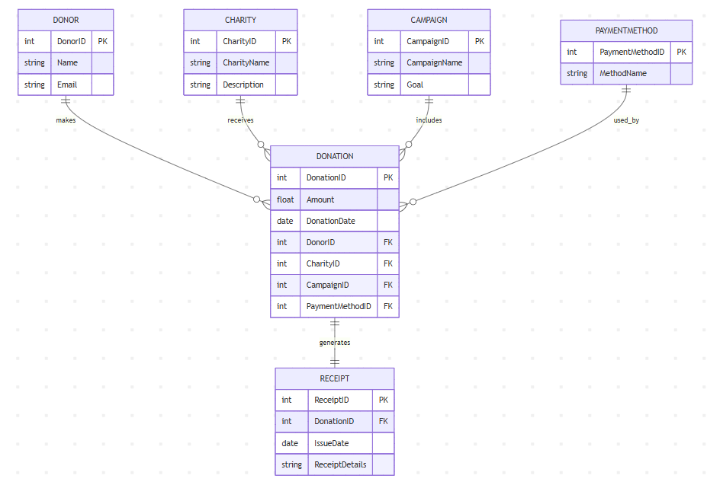
Schema Diagram

Slide 11
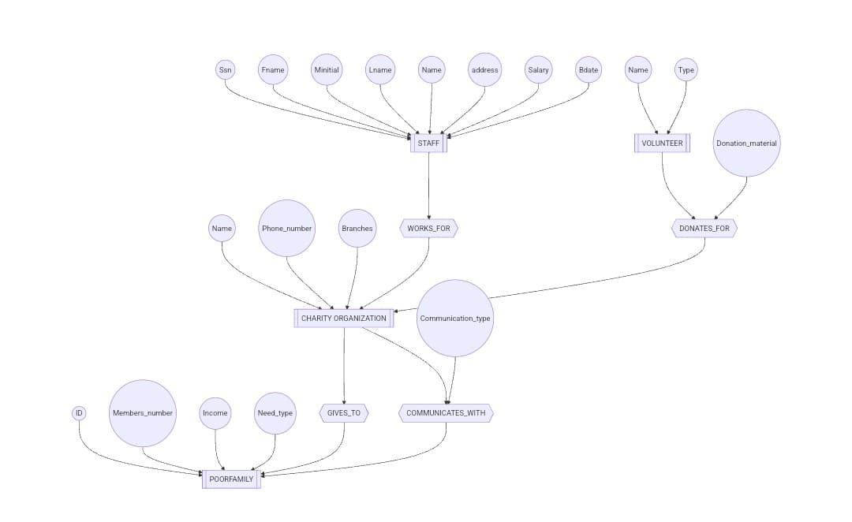
ER diagram

Slide 12
Software Description
The Charity Management System is a database-driven application designed to streamline and automate the management of charitable activities and donations. It enables organizations to efficiently manage donor information, track donations, and monitor the distribution of aid to beneficiaries. The system includes modules for user registration, donation records, event management, and report generation. It ensures data accuracy, security, and transparency in all charity operations. This project aims to enhance operational efficiency and build trust between the organization and its donors.

Slide 13
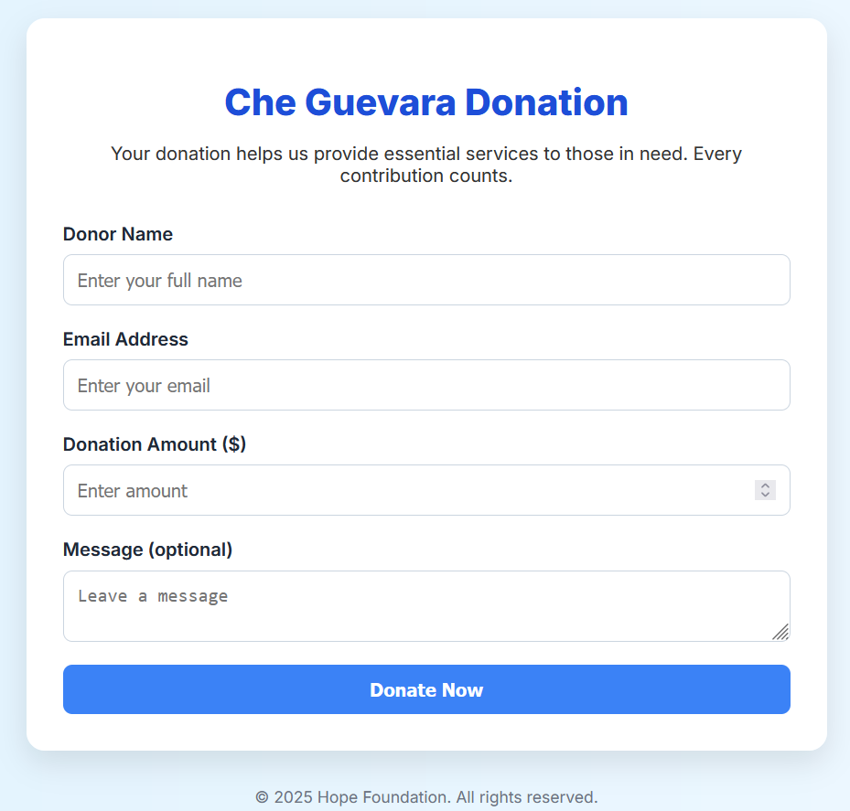
Results & Discussion
This image displays a clean and user-friendly donation form for the "Che Guevara Donation" campaign, managed by the Hope Foundation. The purpose of the form is to collect essential donor information to facilitate charitable contributions. It includes fields for the Donor Name, Email Address, Donation Amount ($), and an optional Message. The form is designed with a clear call-to-action button labeled "Donate Now", encouraging users to submit their donations. At the bottom, it features a copyright notice for the year 2025, reinforcing the foundation's ownership and authenticity. The overall layout emphasizes ease of use, accessibility, and trustworthiness.

Slide 14
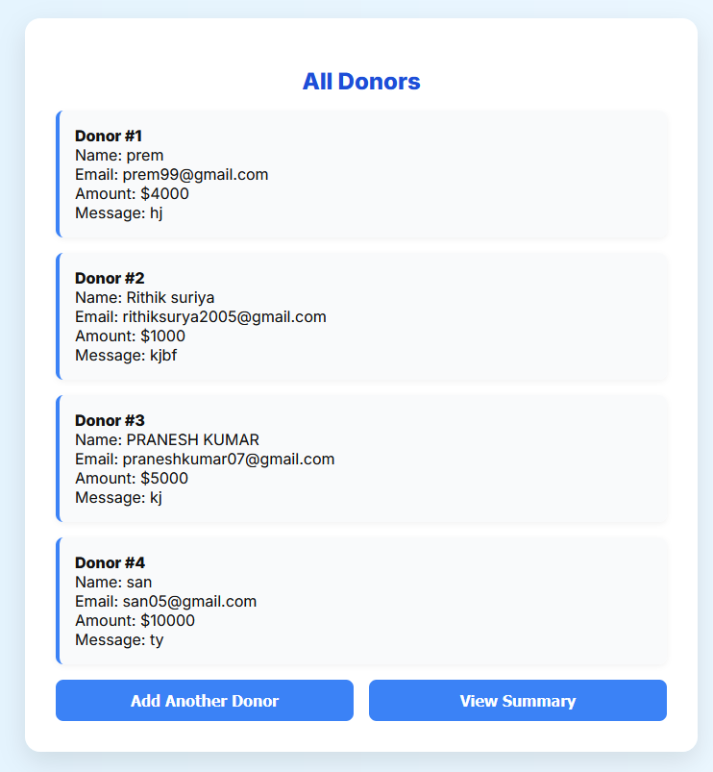
Results & Discussion
The displayed image shows a clean and well-structured donor list section from a charity donation web app. Each donor entry is presented in a card-like layout, displaying the donor’s name, email, donation amount, and message. The entries are numbered for clarity and readability, allowing the organization to track donations efficiently. The background and card design use soft shadows and rounded corners to enhance visual appeal. At the bottom, two prominent buttons allow users to either add another donor or proceed to view the donation summary, improving user navigation and experience.

Slide 15
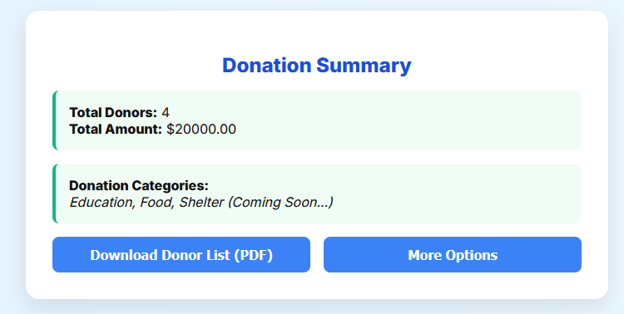
Results & Discussion
The image showcases a well-organized "Donation Summary" slide from a charity management system. It highlights two key metrics: the total number of donors and the total amount donated, offering a clear snapshot of the campaign’s impact. A section below lists donation categories such as Education, Food, and Shelter, with a note indicating that more features are coming soon. The clean design with green-highlighted boxes draws attention to essential figures, making it easy to understand at a glance. Two action buttons—"Download Donor List (PDF)" and "More Options"—enhance interactivity, enabling users to export data or explore further functionalities.

Slide 16
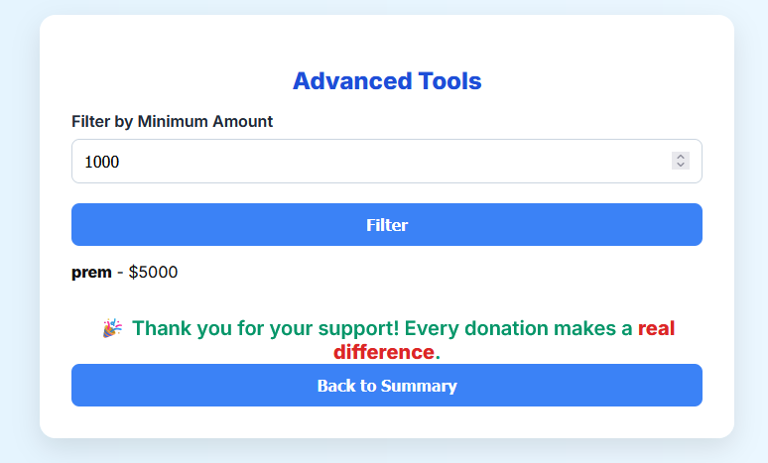
Results & Discussion
The interface shown is part of a donation tracking or management system under the "Advanced Tools" section. It allows users to filter donor records based on a minimum donation amount using a numeric input field. Once the filter is applied, matching donor details, such as name and amount (e.g., "prem - $5000"), are displayed. A cheerful thank-you message acknowledges donor contributions, emphasizing that every donation makes a real difference. A “Back to Summary” button is provided for easy navigation to the main summary page.

Slide 17
Conclusion
This donation platform, Che Guevara Donation, was developed to simplify the donation process and foster a culture of giving. With a clean user interface, real-time donor display, and email integration via EmailJS, the application provides a smooth and impactful experience for both donors and administrators. It demonstrates how front-end technologies like HTML, CSS, and JavaScript can be used to build meaningful, socially driven applications. The project highlights not only technical skills but also the power of design in encouraging community support. This marks a step toward using technology for positive social change.

Slide 18
Reference
[1]. Duckett, J. (2011). HTML and CSS: Design and Build Websites. Wiley.
https://www.wiley.com/en-in/HTML+and+CSS%3A+Design+and+Build+Websites-p-9781118008188
[2]. Flanagan, D. (2020). JavaScript: The Definitive Guide (7th ed.). O’Reilly Media.
https://www.oreilly.com/library/view/javascript-the-definitive/9781491952016/
[3]. Freeman, E., & Robson, E. (2014). Head First HTML and CSS (2nd ed.). O’Reilly Media.

